Slide 1
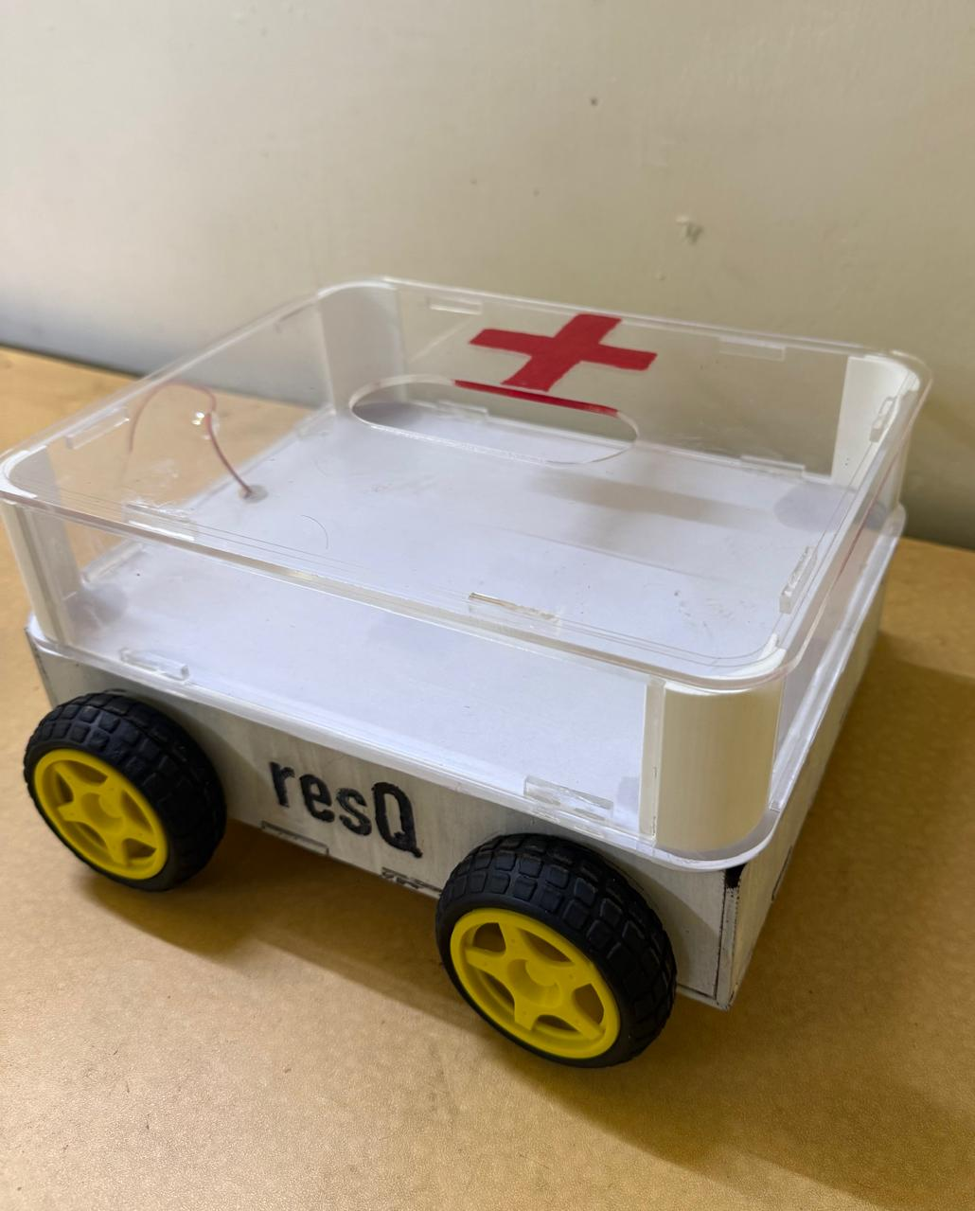
ResQ: The Emergency Response Rover
Presented by Team No. 5 - Nithyam Moosaddee, Dhruv Agarwal, Nishant Gollagunta, Ariana Jalan

Slide 2

600,000 people are injured from skiing and snowboarding accidents every year
Swiss Alps (2022):
3,668 mountain emergencies
109 deaths
70 crevasse falls
.
Every minute matters in freezing temperatures.
Introducing a controlled rover that brings emergency aid to your location before humans can.

Slide 3
The Problem
During activities like skiing or mountain climbing accidents happen and human responders just arent fast enough to render them aid; they are also unprepared for the emergency and have no data on what situation the victim is in.
We wanted to build a rover that could allow people who like adventure to continue to do so in a safer manner.

Slide 4
Our Solution—ResQ
It is a manually controlled rover which would respond to emergencies and take medical supplies to the victim and report back data about the situation so human responders could be better prepared for it.
It would also give victims hope as they would know that we are aware of the emergency and that help is on the way

Slide 5
Obstacles
1
Battery Problem
2
Design Mistakes
We had a power problem since our rover was too heavy, which forced us to increase the power and decrease the weight of the rover.
The 3D CADs that we had designed to be laser cut out of foam had 3 design iterations to improve the fitting of all the components .

Slide 6
Modifications for future
more power: so it reaches the victim faster and can give aid immediately
lower center of mass: so it doesn't topple and gives more stability
snow treads: give easier maneuverability in snowy regions and helps with traction
camera to relay back information abt the victims so that it gives more details about the victim to give more specific medications

Slide 7
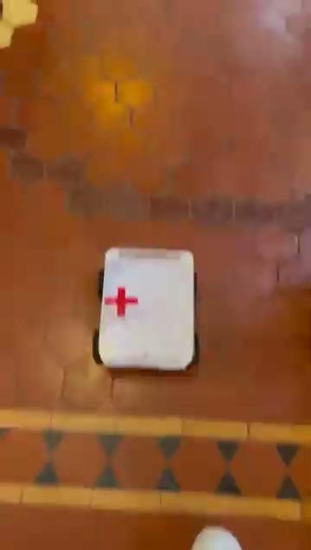
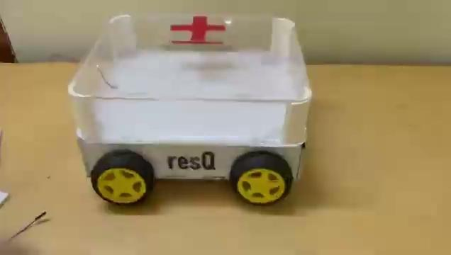
Videos of working prototype

Slide 8
Thank you
Nithyam Moossaddee
Dhruv Agarwal
Nishant Gollagunta
Ariana Jalan

